Slide 1
Plot Search using tf-idf Model From top 100+ list from Rotten Tomatoes
Huang Yanzhen DC126732
Chen Zirui DC127901

Slide 2





1. Introduction
Rotten Tomatoes is a review-aggregation website for film and television in the U.S.
It has its own ranking system of movies, with three tiers: Certified Fresh, Fresh, and Rotten.
Project Goal:
Extract main content of top 100+ movies from RT;
Make a query searcher using TF-IDF Model.
Icon | Score | Description
 | 100–75% | Certified Fresh: Wide-release films with a score of 75% or higher that are reviewed by at least 80 critics, of whom 5 are “Top Critics”. The “Certified Fresh” seal remains until the score drops below 70%. Films with limited releases require only 40 reviews (including 5 from "Top Critics") to qualify for this seal. For TV shows, only individual seasons are eligible for consideration, and each must have at least 20 critic reviews.
 | 100–60% | Fresh: Films or TV shows with a score of 60% or higher that do not meet the requirements for the "Certified Fresh" seal.
 | 59–0% | Rotten: Films or TV shows with a score of 59% or lower receive this seal.

Slide 3
Project Process
Search movie plot among top 100+
Movies
Plots
The bizarre untold truth behind the greatest con in music history -- Milli Vanilli.
Movie 1
2. First Crawler
Craws movie list
Stores in Excel
3. Second Crawler
Extract url list from movie list
Craws url list
Retrieve movie plot list
Store
4. TF-IDF Matrix & Search
Build TF-IDF matrix upon profiles
Search queries on profiles
Improvements: Common word filtering
Problem: Typo-intolerance
To live in Barbie Land is to be a perfect being in a perfect place. Unless you have a full-on existential crisis. Or you're a Ken.
Movie 2
Alice and Jack are lucky to be living in the idealized community of Victory, the experimental company town ...
Movie 118

Slide 4
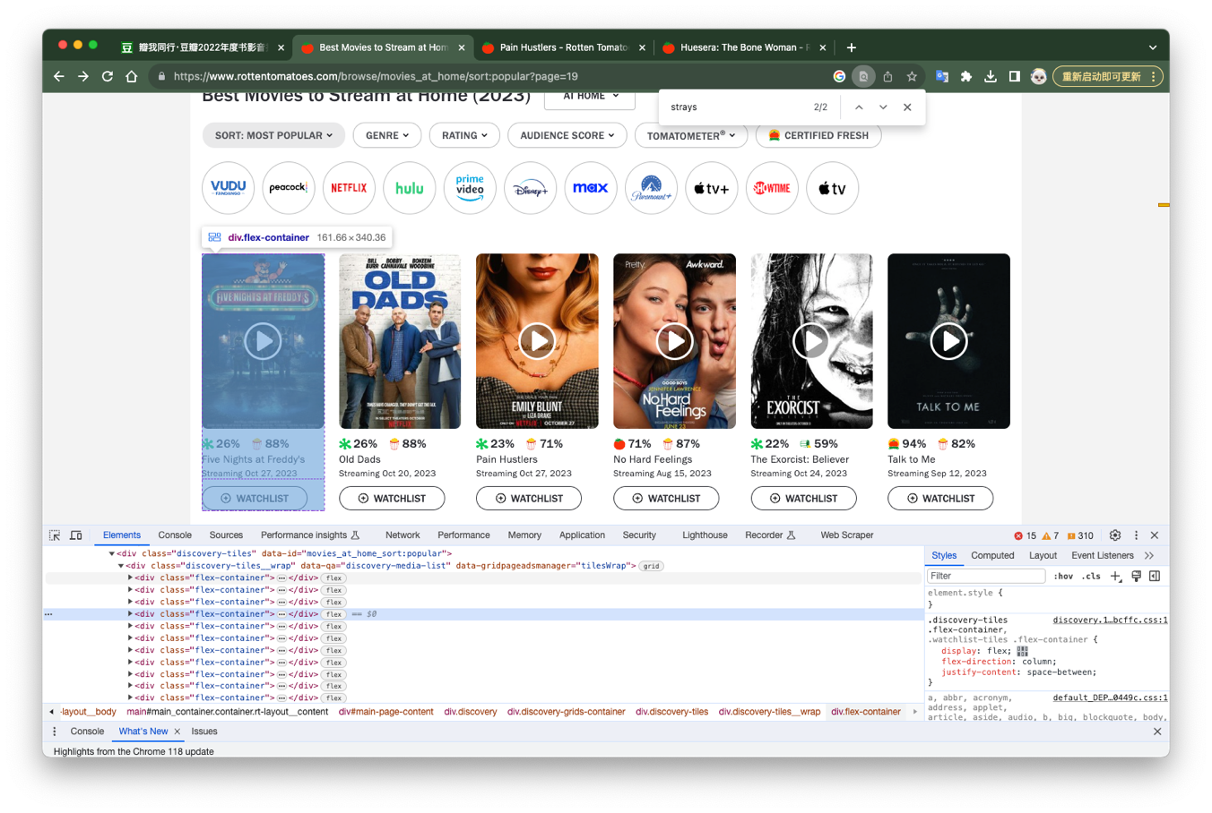
2. First Crawler
Craws Movie List.
The collection of movie items is represented by a grid view of <div> container.
What to do:
Find all of <div> whose class is “flex-container”;
Store all the <div> object in a iterable list;
For each object, extract intended data;
The following part would focus on a specific iteration.

Slide 5
__get_movies__.py
class RTMovieCrawler(scrapy.Spider): name = 'Rotten Tomatoes' allowed_domains = ['rottentomatoes.com'] start_urls = ["https://www.rottentomatoes.com/browse/movies_at_home/sort:popular?page=21"] is_terminal_beautiful = True custom_settings = { # Terminal settings: Ignore some warnings and logs 'LOG_LEVEL': logging.CRITICAL if is_terminal_beautiful is True else logging.ERROR, 'REQUEST_FINGERPRINTER_IMPLEMENTATION': '2.7', # Local settings 'LANG': 'EN', 'USE_EXACT_VALUES': True, 'SAVE_DATA': False, # Don't alter 'ROUND_LEVEL': 3, } # These aren't really useful yet... movie_data = [] article_start_urls = [] index = 1 def parse(self, response): # Entire movie grid movie_list = response.xpath("//div[@class='flex-container']") for movie in movie_list: # Father element: Overall container score_container = movie.xpath(".//a[@data-track='scores']") score_link = score_container.xpath("@href").get() # Title movie_title = score_container.xpath(".//span[@class='p--small']/text()").get() # Guardian method. Don't get useless message if movie_title is None: continue movie_title = re.sub(r"\n|\s","", movie_title) # In fact the movie title from rt is kinda sussy # Stream time stream_time = score_container.xpath(".//span[@class='smaller']/text()").get() stream_time = re.sub(r"\n|\s|Streaming", "", stream_time) # Overall score container evaluation_scores = score_container.xpath(".//score-pairs-deprecated") # Four important scores aud_sentiment = evaluation_scores.xpath("@audiencesentiment").get() aud_score = evaluation_scores.xpath("@audiencescore").get() critics_sentiment = evaluation_scores.xpath("@criticssentiment").get() critics_score = evaluation_scores.xpath("@criticsscore").get()
__get_movies__.py
# Processing data # Change negative/positive to binary expressions, which is a lot easier to cope with bin_aud_sentiment = 0 if aud_sentiment == 'negative' else 1 bin_critics_sentiment = 0 if critics_sentiment == 'negative' else 1 data = { "title": movie_title, "stream_time": stream_time, 'link': score_link, "audience score": aud_score, "critics score": critics_score, "audience sentiment": bin_aud_sentiment, "critics sentiment": bin_critics_sentiment, } # Append movie data... not self.movie_data.append(data) # Store the data in a new Excel file self.start_urls.append("https://www.rottentomatoes.com/" + data['link']) if self.custom_settings['SAVE_DATA']: __save_data__.save_data_to_excel(data) # Print beautiful data in console :) print("--------------------") print( str(self.index) + '\n' + "title: " + movie_title + '\n' + "stream time: " + stream_time + '\n' + "link:" + score_link + '\n' + "audience sentiment: " + aud_sentiment + '\n' + "audience score: " + aud_score + '\n' + "critics sentiment: " + critics_sentiment + '\n' + "critics score: " + critics_score ) # This thread is async so I have to do this to omit race conditions self.index += 1 def run_process(): process = CrawlerProcess() process.crawl(RTMovieCrawler) process.start() run_process()
Encapsulate data into a dictionary
Save data into excel
Fetch url

Slide 6
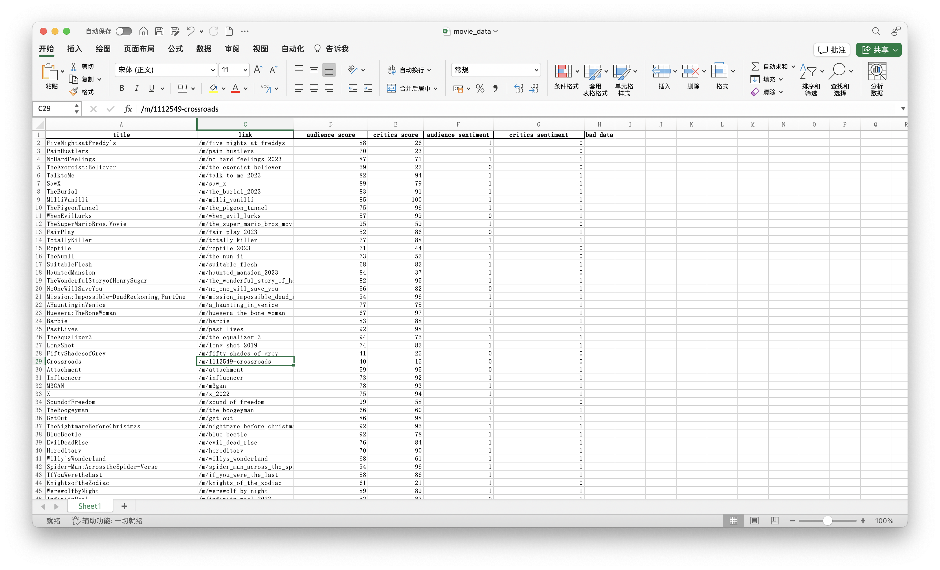
2. First Crawler
Data stored in excel file:
movie_data.xls

Slide 7
3. Second Crawler
__settings__.py
def get_movie_url(): # Read Excel file and do analysis file_path = './movie_list/movie_data.xlsx' movie_data = pd.read_excel(file_path) # Get URL url_series = movie_data['link'] sub_urls = url_series.values # Header URL header_url = 'https://www.rottentomatoes.com' urls = np.array(sub_urls, dtype=object) urls_with_header = header_url + urls print(len(urls_with_header)) return urls_with_header
One movie, one url.
Extract urls from excel files as the start_urls of the second crawler.
The second crawler craws movie plot content, stores them into another excel file.
Concat with base url
Notes:
Having the url list, we have the second crawler to crawl movie contents of each movie. One movie, with one url, which leads to one movie content, i.e., plots. We wrote a special function to read excel file and form an array of movie urls.

Slide 8
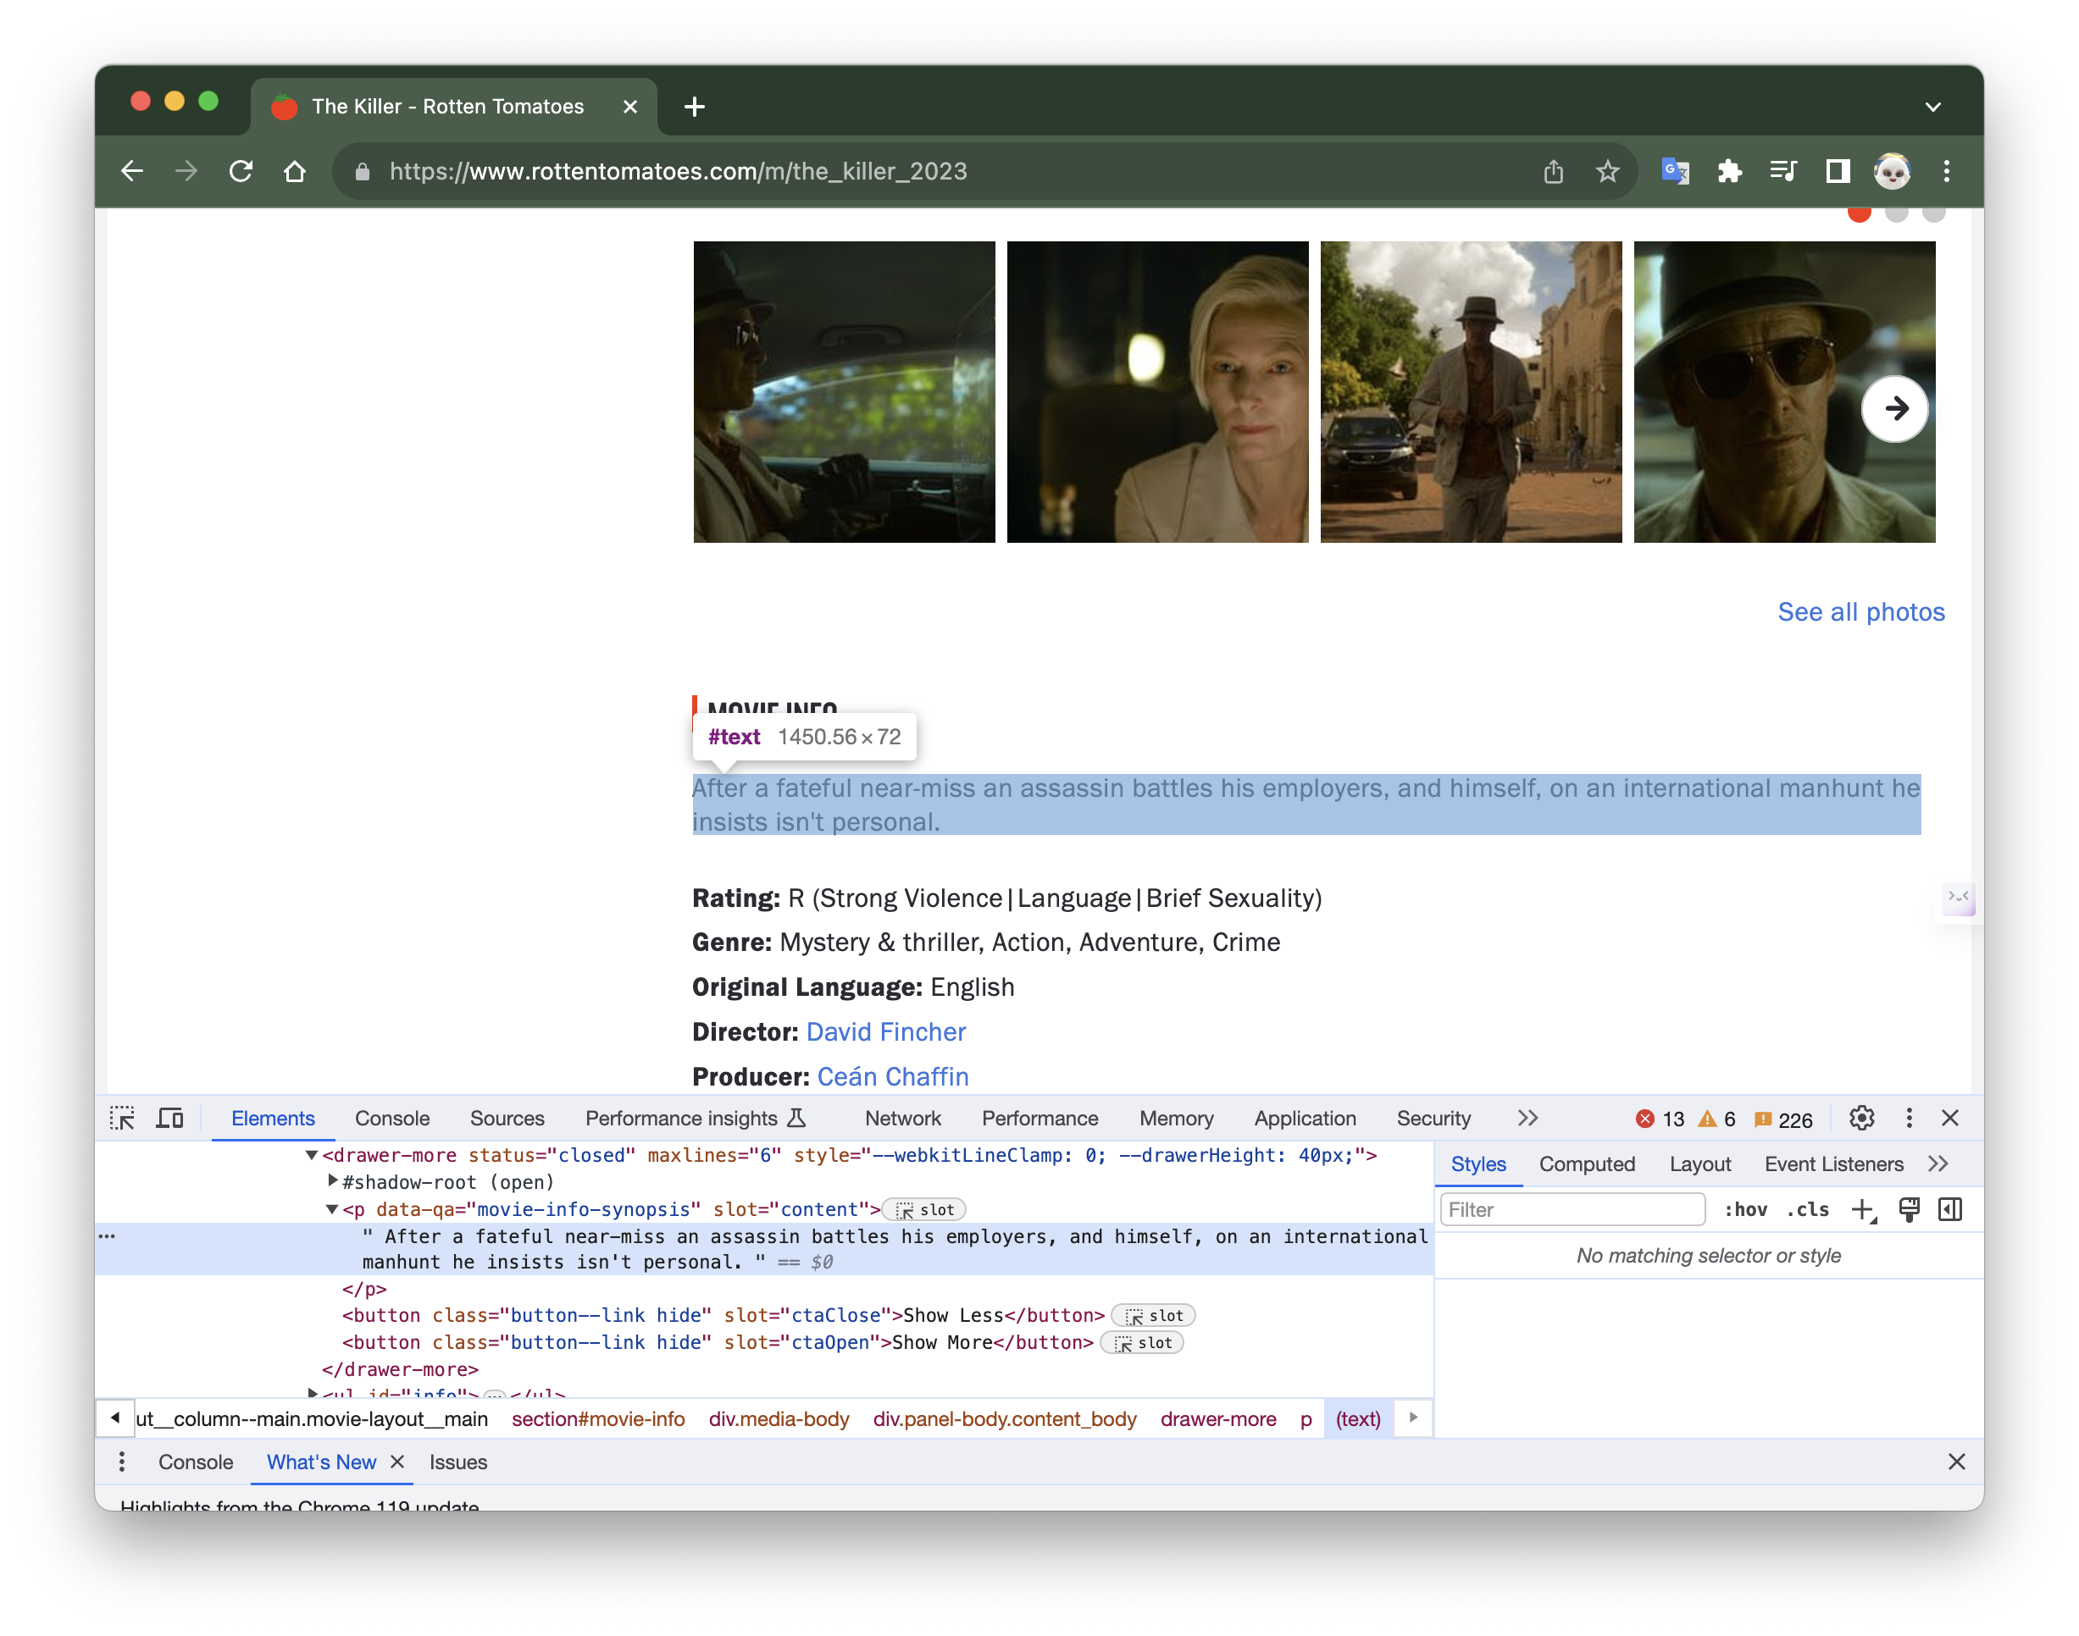
3. Second Crawler
The movie plot is stored in a <p> tag, with attribute:
data-qa=“movie-info-synopsis”
slot=“content”
Extract using xpath.
Notes:
The url leads to the detail page of a movie. The plot is stored in a paragraph element, having attribute slot="content". So we can extract it using xpath.

Slide 9
__get_movies_detail__.py
class MovieDetailCrawler(scrapy.Spider): name = 'rotten_tomatoes' allowed_domains = ['rottentomatoes.com'] is_terminal_beautiful = False start_urls = __settings__.get_movie_url() custom_settings = { # Terminal settings: Ignore some warnings and logs # 'LOG_LEVEL': logging.ERROR, # 'REQUEST_FINGERPRINTER_IMPLEMENTATION': '2.7', # Local settings 'LANG': 'EN', 'USE_EXACT_VALUES': True, 'SAVE_DATA': True, 'ROUND_LEVEL': 3, } def start_requests(self): for url in self.start_urls: headers = { 'User-Agent': self.get_random_user_agent() } yield scrapy.Request(url=url, headers=headers, callback=self.parse) # Use dynamic agent to avoid my IP to get banned def get_random_user_agent(self): user_agents = [ 'Mozilla/5.0 (Windows NT 10.0; Win64; x64) AppleWebKit/537.36 (KHTML, like Gecko) Chrome/88.0.4324.150 Safari/537.36', 'Mozilla/5.0 (Windows NT 10.0; Win64; x64) AppleWebKit/537.36 (KHTML, like Gecko) Chrome/89.0.4389.82 Safari/537.36', 'Mozilla/5.0 (Macintosh; Intel Mac OS X 10_15_7) AppleWebKit/537.36 (KHTML, like Gecko) Chrome/88.0.4324.150 Safari/537.36', 'Mozilla/5.0 (Macintosh; Intel Mac OS X 10_15_7) AppleWebKit/537.36 (KHTML, like Gecko) Chrome/89.0.4389.82 Safari/537.36', 'Mozilla/5.0 (Windows NT 10.0; Win64; x64; rv:85.0) Gecko/20100101 Firefox/85.0', ] return random.choice(user_agents) def parse(self, response): title = response.xpath("//h1[@class='title']/text()").get() genre = response.xpath("//span[@class='genre']/text()").get() genre = re.sub(r'\n|\s|\t', '', genre) content = response.xpath("//p[@slot='content']/text()").get() content = re.sub(r'\n|\t', '', content)
__get_movies_detail__.py
data = { "title": title, "genre": genre, "content": content, } # Save data if self.custom_settings['SAVE_DATA']: __save_data__.save_data_to_excel(data, file_name="movie_content") print("\n title:" + title) print("\n genre:" + genre) print("\n content:\n" + content)
1. Initialize start url list
4. Store data into another excel file.
2. Traverse the url list
__settings__.py
def get_movie_url(): # Read Excel file and do analysis file_path = './movie_list/movie_data.xlsx' movie_data = pd.read_excel(file_path) # Get URL url_series = movie_data['link'] sub_urls = url_series.values # Header URL header_url = 'https://www.rottentomatoes.com' urls = np.array(sub_urls, dtype=object) urls_with_header = header_url + urls print(len(urls_with_header)) return urls_with_header
3. Retrieve plots, and do some liguistic tricks to make it into a single string.
Notes:
Here is the code. We first initialize the start url by calling the get_movie_url function. Then, in start_requests() function, there is a for loop, traversing each start url. In each for loop, the function parse is called with the corresponding url as parameter.

Slide 10
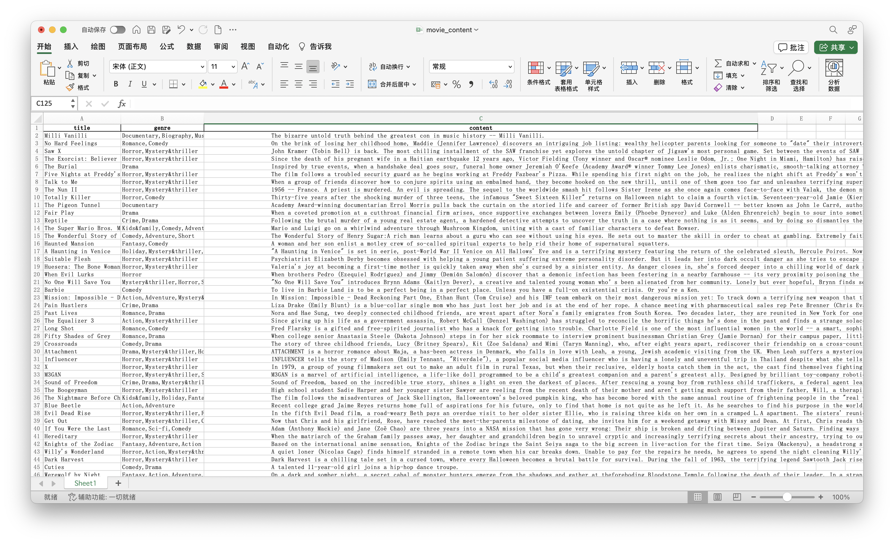
3. Second Crawler
Data stored in excel file:
movie_content.xls
Notes:
The xpath retrieving the plot is "//p[@slot='content']/text()". We use regular expression tools to remove enters and tabs. Lastly, we store the retrieved content data into another excel file.

Slide 11
4. TF-IDF Matrix & Search
Original Queries:
Article 1
It iscake.
Article 2
The cake tastes like cake.
Article 3
The cake is a lie.
Basic Idea:
1. For each article, tokenize into an array of string;
2. Summarize the string array into term frequency vectors;
3. Combine multiple vectors, removing duplicates. This forms an array of term-frequency vectors.
4. Further combine tf vectors into tf matrix.
Tokenized:
Article 1
it
is
cake
Article 2
the
cake
tastes
like
cake
Article 3
the
cake
is
a
lie
Term frequency vectors:
Article 1: { ‘it’:1, ‘is’:1, ‘cake’:1}
Article 2: { ‘the’:1, ‘cake’:2, ‘tastes’:1, ‘like’: 1}
Article 3: { ‘the’:1, ‘cake’:1, ‘is’:1, ‘a’:1, ‘lie’:1}
Notes:
TF-IDF Matrix & Search
The rest part is very simple.
For each plot as a single string, tokenize it into an array of words;
Sums the duplicates within each array, forming a term-frequency vector. Each tf vector corresponds to a movie plot;
Combine multiple vectors into a tf matrix.
Lastly, calculate idf and forms a tf-idf matrix.
Let me give you a demo.

Slide 12
4. TF-IDF Matrix & Search
Term frequency matrix:
 | Query 1 | Query 2 | Query 3
it | 1 | 0 | 0
is | 1 | 0 | 1
cake | 1 | 2 | 1
the | 0 | 1 | 1
tastes | 0 | 1 | 0
like | 0 | 1 | 0
a | 0 | 0 | 1
lie | 0 | 0 | 1
Basic Idea:
4. Further combine tf vectors into tf matrix.
5. Calculate inverse document frequency
6. Calculate tf-idf matrix
tf-idf vector:
 | inverse document frequency
it | 0.18
is | 0
cake | -0.22
the | 0
tastes | 0.18
like | 0.18
a | 0.18
lie | 0.18

Slide 13
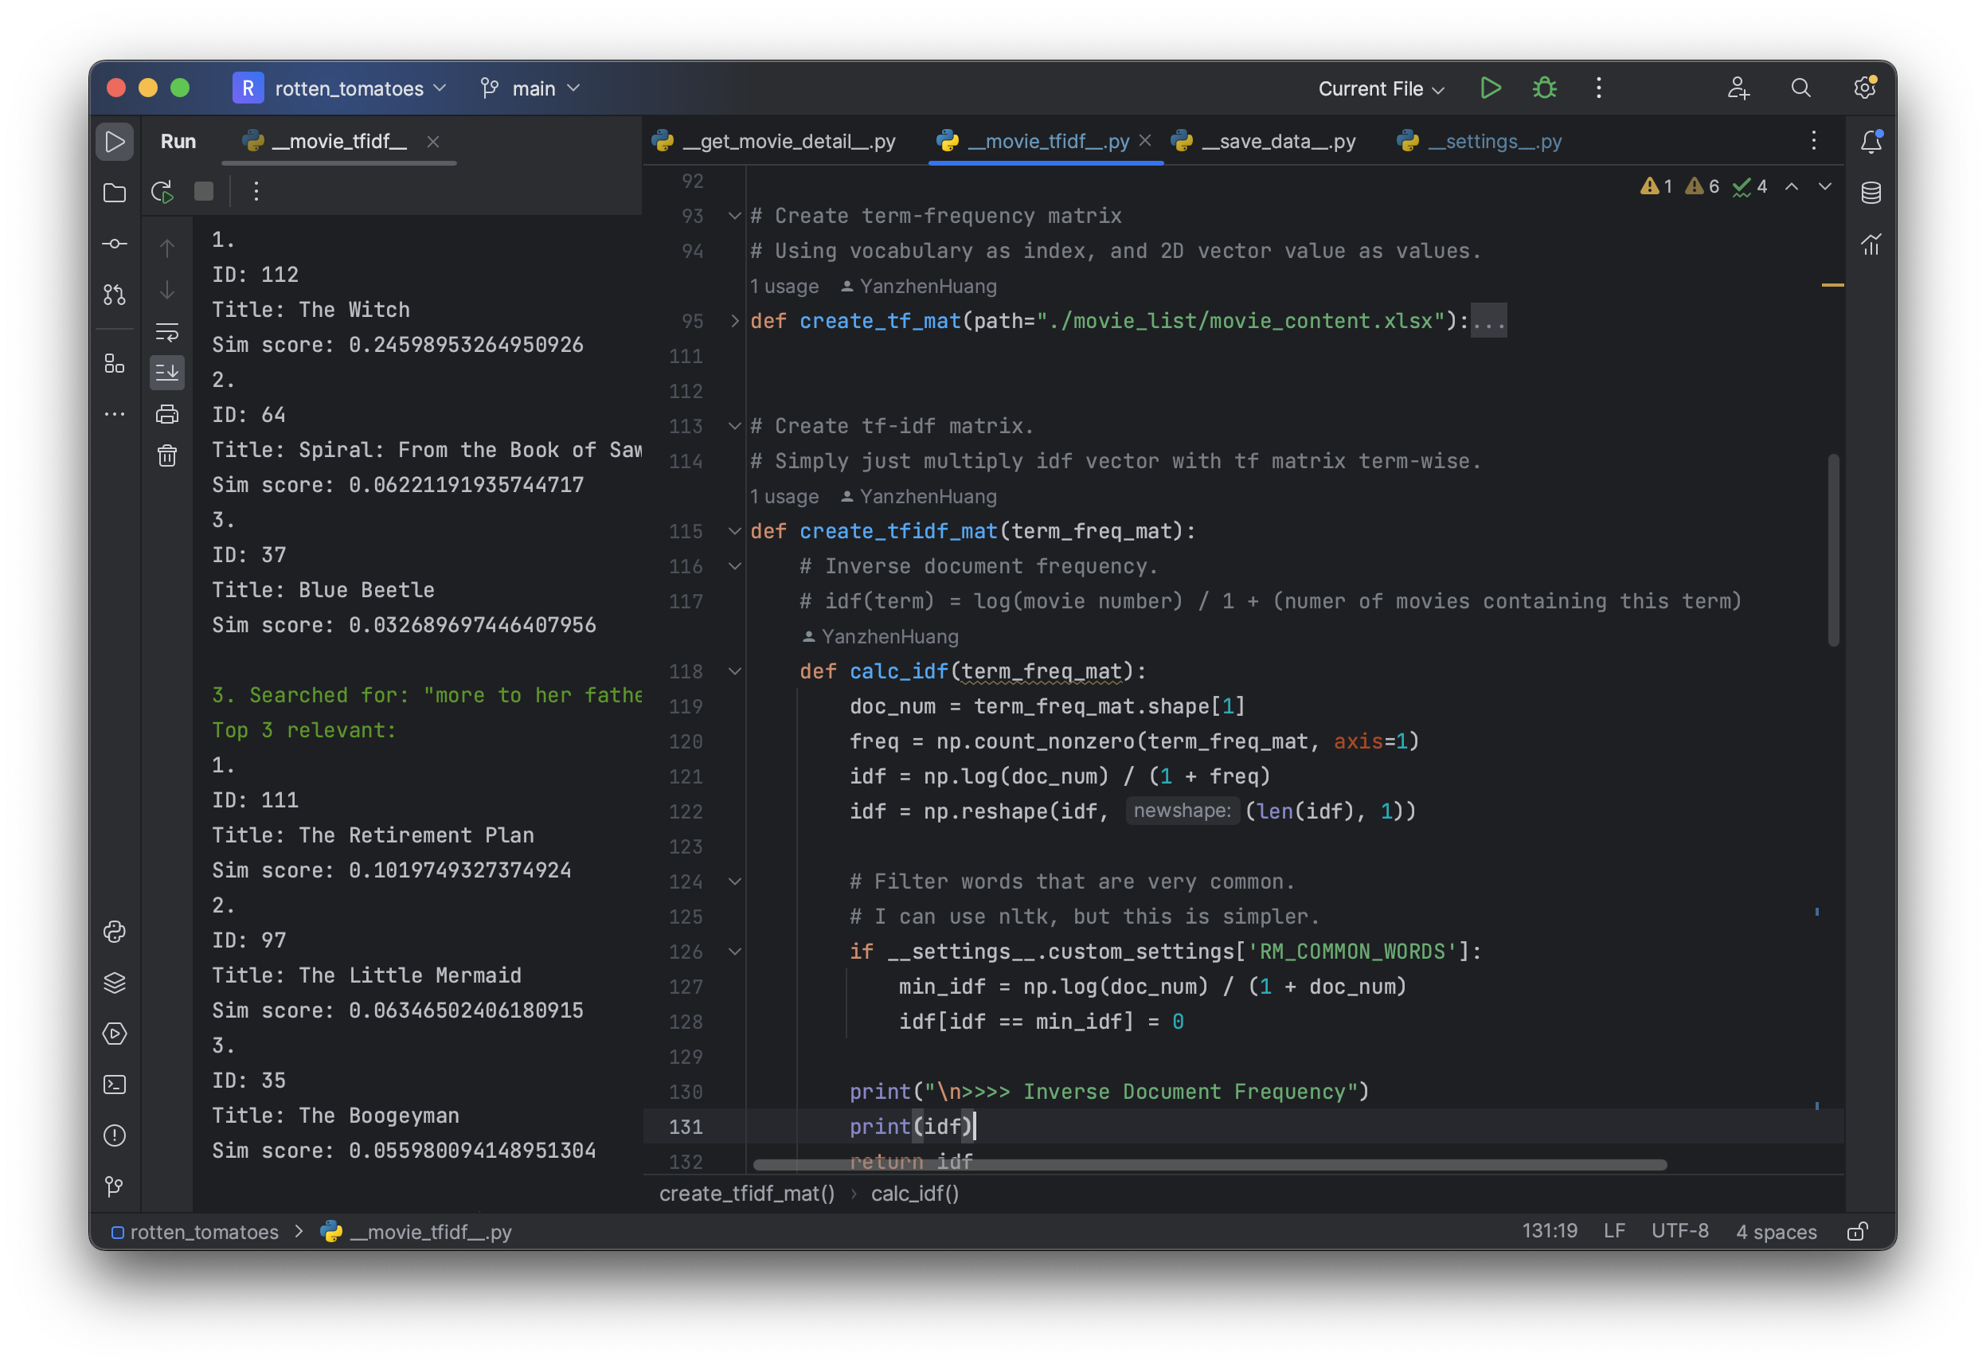
4. TF-IDF Matrix & Search
Code preview

Slide 14
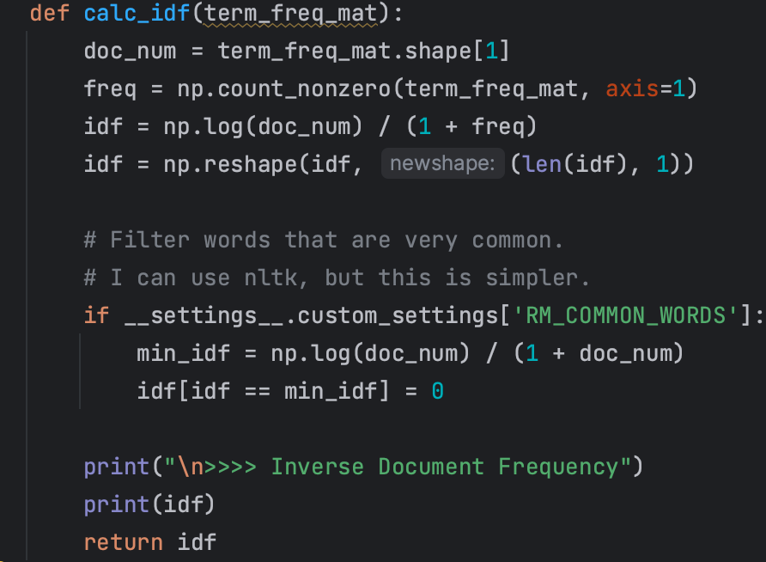
4. TF-IDF Matrix & Search
These two queries comes from the same article;
When we initially used the two queries to test the algorithm, we expected that it should yield the same results;
However, it yields a different result.
We figured out that, it’s because that in the string below, the word “city” occurred too many times such that, even if the tf-idf value of “city” is very small (since it’s very common), its contribution is still evidently large.
We solved it by cascading the idf value:
Problems in search:
1. Too sensitive to common words.
As an idf of a word reaches the smallest possible value, we strictly let it become 0. This is based on the fact that this word is too common to contribute a good result for a search.

Slide 15
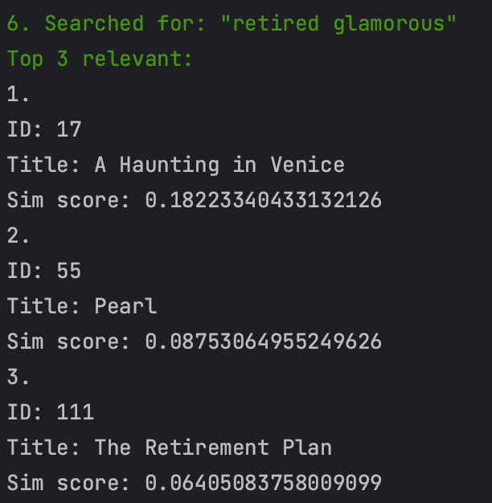
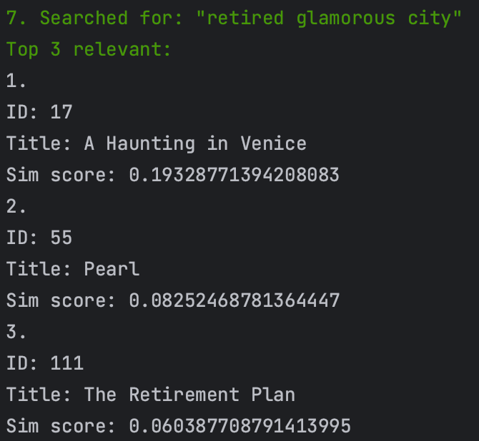
4. TF-IDF Matrix & Search
Search string = “retired glamorous city”
ID=17: (correct)
"A Haunting in Venice" is set in eerie, post-World War II Venice on All Hallows' Eve and is a terrifying mystery featuring the return of the celebrated sleuth, Hercule Poirot. Now retired and living in self-imposed exile in the world's most glamorous city, Poirot reluctantly attends a séance at a decaying, haunted palazzo. When one of the guests is murdered, the detective is thrust into a sinister world of shadows and secrets.
Problems in search:
1. Too sensitive to common words.
In fact, this change improves the accuracy of search alot.
Another alternative is to use NLKT to filter stop words in search query.
ID=94: (incorrect)
For over fifty years, Judy Blume's classic and groundbreaking novel Are You There God? It's Me, Margaret. has impacted generations with its timeless coming of age story, insightful humor, and candid exploration of life's biggest questions. In Lionsgate's big-screen adaptation, 11-year-old Margaret (Abby Ryder Fortson) is uprooted from her life in New York City for the suburbs of New Jersey, going through the messy and tumultuous throes of puberty with new friends in a new school. She relies on her mother, Barbara (Rachel McAdams), who is also struggling to adjust to life outside the big city, and her adoring grandmother, Sylvia (Kathy Bates), who isn't happy they moved away and likes to remind them every chance she gets.

Slide 16
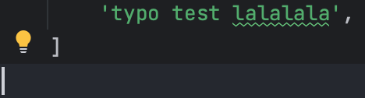
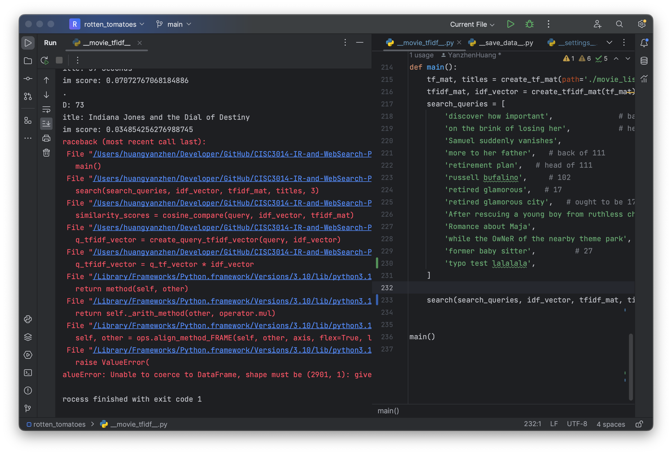
4. TF-IDF Matrix & Search
Any typo will cause an array outrange exception!
Problems in search:
2. ZERO tolerance on typo.
TF-IDF model can only measure the occurance of KNOWN words.
By giving a completely new key, the query tf-idf vector will be 1 unit longer than the rows of tf-idf matrix, resulting the exception.
Can only be fixed by correcting the query string.

Slide 17
4. TF-IDF Matrix & Search
Problems in search:
3. Doesn’t care about sequence
“A exceeds B” = “B exceeds A”
Doesn’t contribute much error to searching.
In fact, after fixing the first issue, the search works pretty fine.

Slide 18
Thank You!

